Slide 1

Image Dehazing
name: Kunal R. Pedhambkar
Supervisor Name: Mrs. Shubhangi Ghate

Slide 2
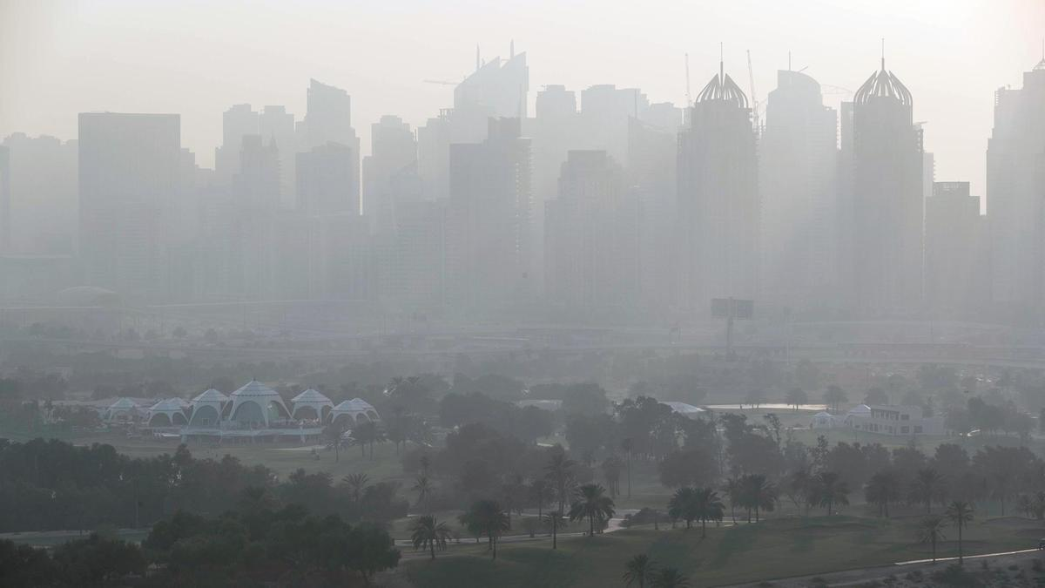
Introduction
Haziness is a huge obstacle in visibility applications. It is very important to remove Haze efficiently. Outdooar scenes and images lose the quality, degrade under the bad weather conditions, and provide Hazy images.
Haziness is caused due to impurities in air. Due to haze clarity of images will be degraded. Haziness constitutes of “Airlight” and “Direct attenuation” i.e., Haze = Attenuation + Airlight
In such conditions Images quality deteriorates. These Low Quality Images are not efficient in Digital Image Processing. To Improve the Quality of the Image it is Necessary to remove the haze.

Slide 3
Applications of Image dehazing
Digital image processing, as a computer-based technology, carries out automatic processing, manipulation and interpretation of such visual information, and it plays an increasingly important role in many aspects of our daily life, as well as in a wide variety of disciplines and fields in science and technology, with applications such as television, photography, robotics, remote sensing, medical diagnosis and industrial inspection.
Computerized photography (e.g., Photoshop)
Space image processing (e.g., Hubble space telescope images, interplanetary probe images)
Medical/Biological image processing (e.g., interpretation of X-ray images, blood/cellular microscope images)
Automatic character recognition (zip code, license plate recognition)
Finger print/face/iris recognition
Remote sensing: aerial and satellite image interpretations
Reconnaissance
Industrial applications (e.g., product inspection/sorting)

Slide 4

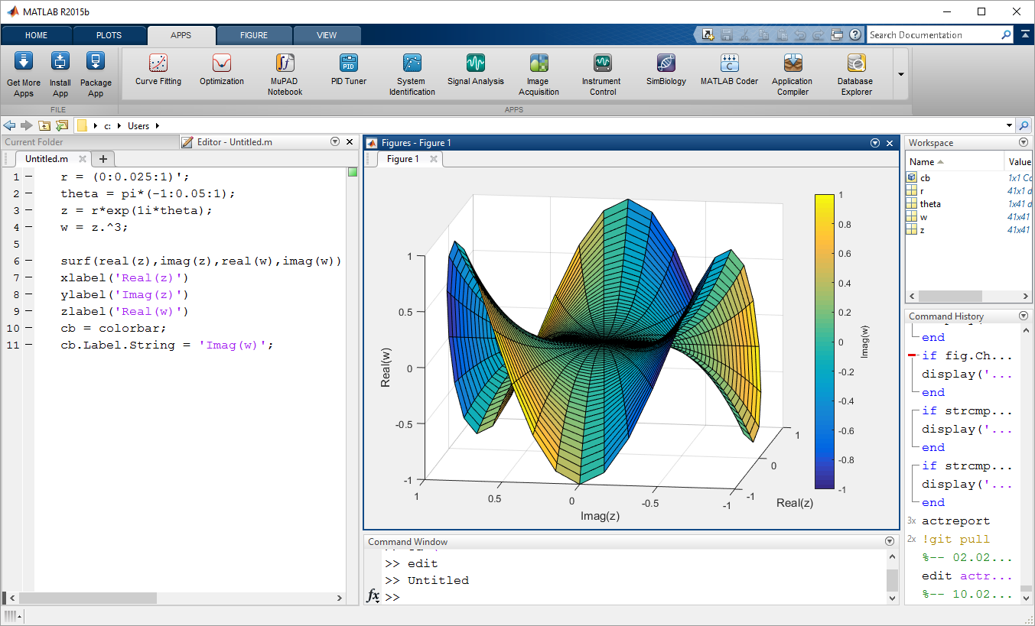
Software Used
MATLAB is The Best Software for Image Processing
and Image Dehazing as it has various Functionalities to
Easily plot graphs and view edited Images.

